Slide 1


CS 188: Artificial Intelligence
Learning II: Decision Tree & Logistic Regression
Instructors: Stuart Russell and Dawn Song
University of California, Berkeley
Notes:
Please retain proper attribution, including the reference to ai.berkeley.edu. Thanks!

Slide 2
Recap: Supervised learning
To learn an unknown target function f
Input: a training set of labeled examples (x_{j},y_{j}) where y_{j} = f(x_{j})
E.g., x_{j} is an image, f(x_{j}) is the label “giraffe”
E.g., x_{j} is a seismic signal, f(x_{j}) is the label “explosion”
Output: hypothesis h that is “close” to f, i.e., predicts well on unseen examples (“test set”)
Many possible hypothesis families for h
Linear models, logistic regression, neural networks, decision trees, examples (nearest-neighbor), grammars, kernelized separators, etc etc
Classification = learning f with discrete output value
Regression = learning f with real-valued output value

Slide 3
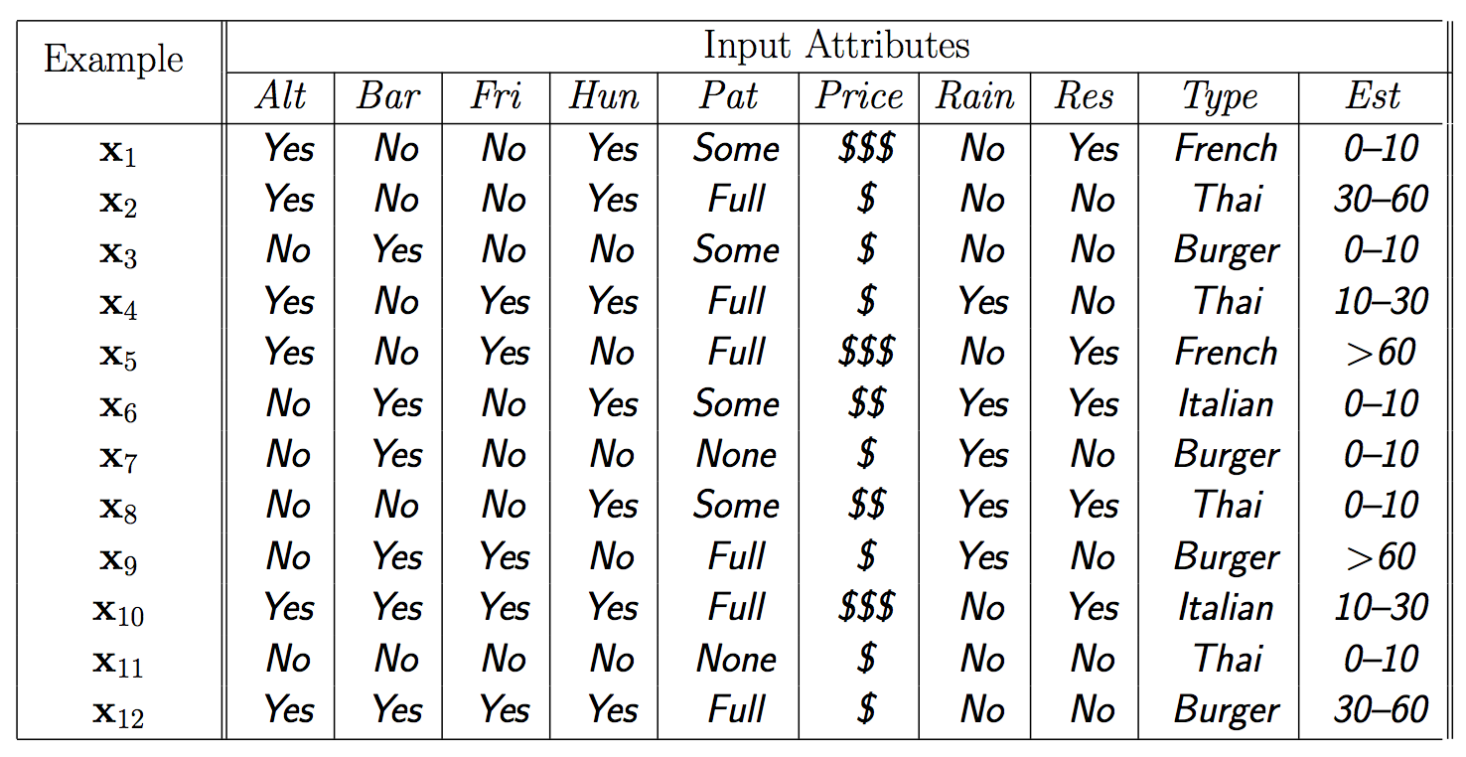
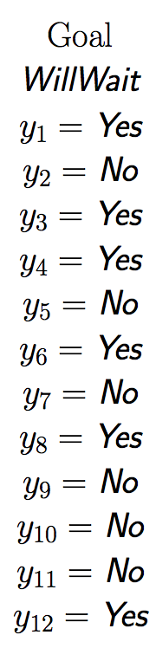
Training data

Slide 4
Learning a Decision Tree
Goal
Given training data of a list of attributes & label
Hypothesis family H: decision trees
Find (approximately) the smallest decision tree that fits the training data
Iterative process to choose the next attribute to split on

Slide 5
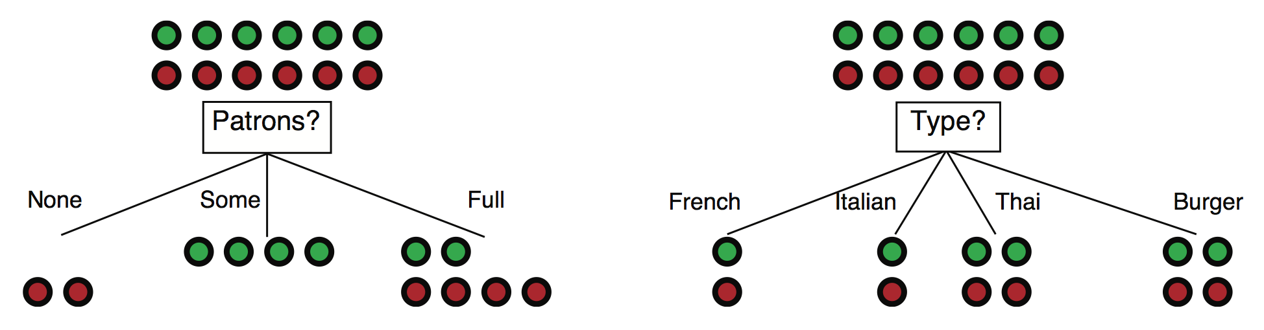
Choosing an attribute: Information gain
Idea: measure contribution of attribute to increasing “purity” of labels in each subset of examples; find most distinguishing feature
Patrons is a better choice: gives information about classification; more distinguishing feature

Slide 6
Information
Information answers questions
The more clueless I am about the answer initially, the more information is contained in the answer
Scale: 1 bit = answer to Boolean question with prior ⟨0.5, 0.5⟩
For a coin with probability p heads, entropy H( ⟨p,1-p⟩) = –plog p –(1-p)log (1-p)
Convenient notation: B(p) = H(⟨p,1-p⟩)

Slide 8
Information
Information in an answer when prior is ⟨p₁,…,p_{n}⟩ is
H(⟨p₁,…,p_{n}⟩) = Σ_{i} –p_{i} log p_{i}
This is the entropy of the prior
Entropy was initially proposed in physics (thermodynamics)
Shannon developed information theory, using entropy to measure information

Slide 9

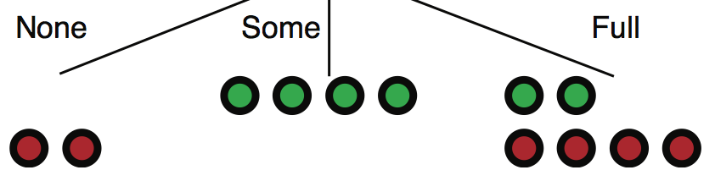
Information gain from splitting on an attribute
Suppose we have p positive and n negative examples at the root
=> ___________ bits needed to classify a new example
E.g., for 12 restaurant examples, p = n = 6 so we need ____ bit
An attribute splits the examples E into subsets E_{k}, each of which (we hope) needs less information to complete the classification
For an example in E_{k} we expect to need __________ more bits
Probability a new example goes into E_{k} is
Expected number of bits needed after split is
Information gain =___________________
_____________
____________

Slide 10
Information gain from splitting on an attribute
Suppose we have p positive and n negative examples at the root
=> B(p/(p+n)) bits needed to classify a new example
E.g., for 12 restaurant examples, p = n = 6 so we need 1 bit
An attribute splits the examples E into subsets E_{k}, each of which (we hope) needs less information to complete the classification
For an example in E_{k} we expect to need B(p_{k}/(p_{k}+n_{k})) more bits
Probability a new example goes into E_{k} is
Expected number of bits needed after split is
Information gain = B(p/(p+n)) - Σ_{k} (p_{k}+n_{k})/(p+n) B(p_{k}/(p_{k}+n_{k}))
(p_{k}+n_{k})/(p+n)
Σ_{k} (p_{k}+n_{k})/(p+n) B(p_{k}/(p_{k}+n_{k}))

Slide 11
Example
Information gain?

Slide 12
Example
1 – [(2/12)B(0) + (4/12)B(1) + (6/12)B(2/6)]
= 0.541 bits
1 – [(2/12)B(1/2) + (2/12)B(1/2) +
(4/12)B(2/6) + (4/12)B(1/2)]
= 0 bits

Slide 13
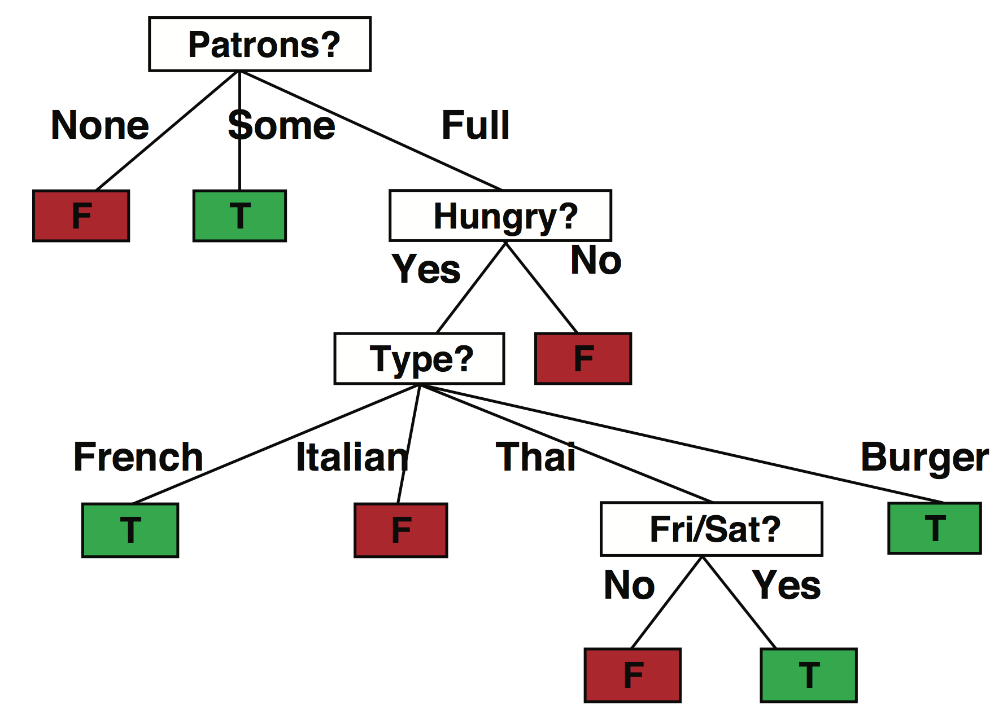
Results for restaurant data
Decision tree learned from the 12 examples:
Simpler than “true” tree!

Slide 14
Decision tree learning
function Decision-Tree-Learning(examples,attributes,parent_examples) returns a tree
if examples is empty then return Plurality-Value(parent_examples)
else if all examples have the same classification then return the classification
else if attributes is empty then return Plurality-Value(examples)
else A ← argmax_{a} _{∈ attributes} Importance(a, examples)
tree ← a new decision tree with root test A
for each value v of A do
exs ← the subset of examples with value v for attribute A
subtree ← Decision-Tree-Learning(exs, attributes − A, examples)
add a branch to tree with label (A = v_{k}) and subtree subtree
return tree
Plurality-Value selects the most common output value among a set of examples

Slide 15
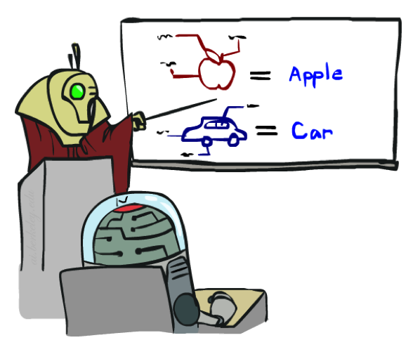


Training and Testing

Slide 16



A few important points about learning
Data: labeled instances, e.g. emails marked spam/ham
Training set
Held out set
Test set
Features: attribute-value pairs which characterize each x
Experimentation cycle
Learn parameters (e.g. model probabilities) on training set
(Tune hyperparameters on held-out set)
Compute accuracy of test set
Very important: never “peek” at the test set!
Evaluation
Accuracy: fraction of instances predicted correctly
Overfitting and generalization
Want a classifier which does well on test data
Overfitting: fitting the training data very closely, but not generalizing well
Underfitting: fits the training set poorly
Training
Data
Held-Out
Data
(Validation set)
Test
Data

Slide 17








A few important points about learning
What should we learn where?
Learn parameters from training data
Tune hyperparameters on different data
Why?
For each value of the hyperparameters, train and test on the held-out data
Choose the best value and do a final test on the test data
What are examples of hyperparameters?

Slide 18
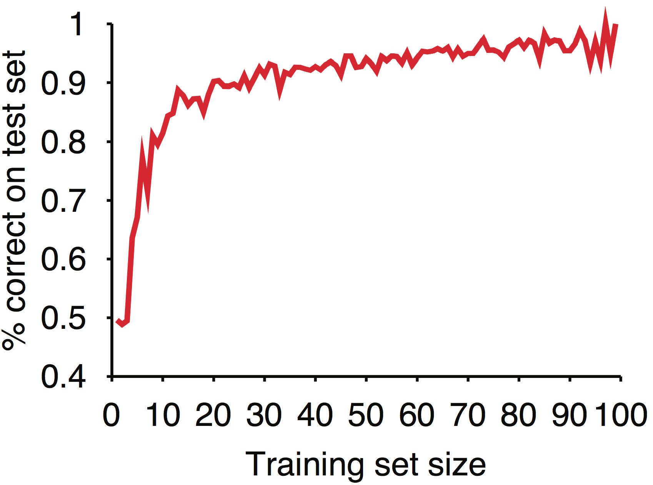
Results for restaurant data

Slide 19
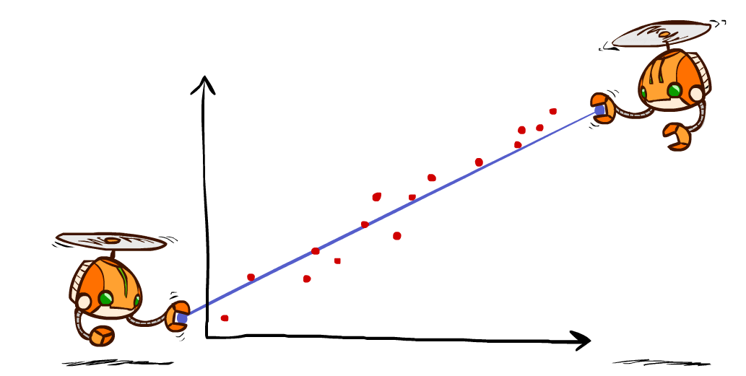
Linear Regression

Slide 20
Linear regression = fitting a straight line/hyperplane
40
h_{w}(x)
20
0
0
x
20
Prediction: h_{w}(x) = w₀ + w₁x
Berkeley house prices, 2009
Notes:
Figure 1: scatter(1:20,10+(1:20)+2*randn(1,20),'k','filled'); a=axis; a(3)=0; axis(a);

Slide 21
Prediction error
Error on one instance: y – h_{w}(x)
Error or “residual”
Observation y
Prediction h_{w}(x)
0
x
0
20
Notes:
Figure 1: scatter(1:20,10+(1:20)+2*randn(1,20),'k','filled'); a=axis; a(3)=0; axis(a);

Slide 22
Least squares: Minimizing squared error
L2 loss function: sum of squared errors over all examples
Loss = Σ_{j} (y_{j} – h_{w}(x_{j}))² = Σ_{j} (y_{j} – (w₀ + w₁x_{j}))²
We want the weights w* that minimize loss
At w* the derivatives of loss w.r.t. each weight are zero:
∂Loss/∂w₀ = – 2 Σ_{j} (y_{j} – (w₀ + w₁x_{j})) = 0
∂Loss/∂w₁ = – 2 Σ_{j} (y_{j} – (w₀ + w₁x_{j})) x_{j} = 0
Exact solutions for N examples:
w₁ = [NΣ_{j} x_{j}y_{j} – (Σ_{j} x_{j})(Σ_{j} y_{j})]/[NΣ_{j} x_{j}² – (Σ_{j} x_{j})²] and w₀ = 1/N [Σ_{j} y_{j} – w₁Σ_{j} x_{j}]
For the general case where x is an n-dimensional vector
X is the data matrix (all the data, one example per row); y is the column of labels
w* = (X^{T}X)⁻¹X^{T}y

Slide 23
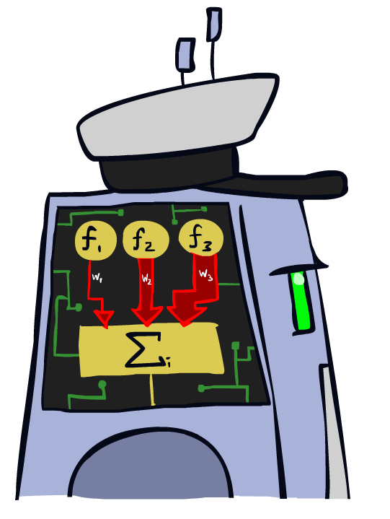
Linear Classifiers

Slide 24
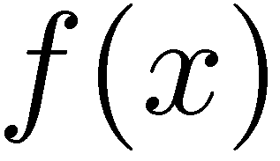



Feature Vectors
Hello,
Do you want free printr cartriges? Why pay more when you can get them ABSOLUTELY FREE! Just
# free : 2
YOUR_NAME : 0
MISSPELLED : 2
FROM_FRIEND : 0
...
SPAM
or
+
PIXEL-7,12 : 1
PIXEL-7,13 : 0
...
NUM_LOOPS : 1
...
“2”

Slide 25
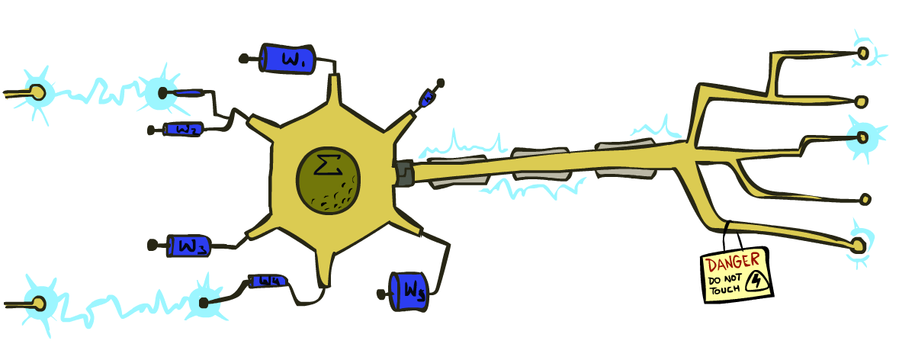
Some (Simplified) Biology
Very loose inspiration: human neurons

Slide 26
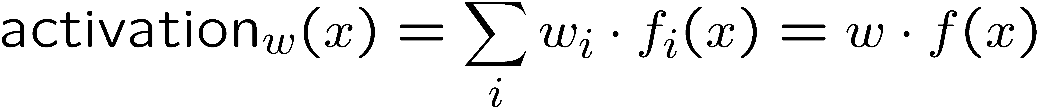
Linear Classifiers
Inputs are feature values
Each feature has a weight
Sum is the activation
If the activation is:
Positive, output +1
Negative, output -1
w₁
f₁
Σ
w₂
>0?
f₂
w₃
f₃

Slide 27


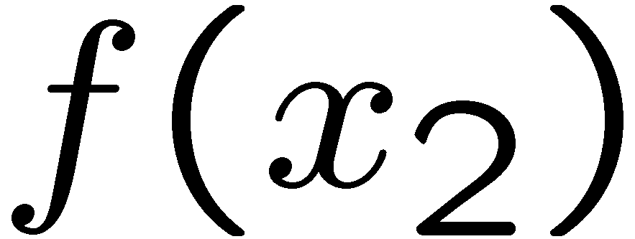
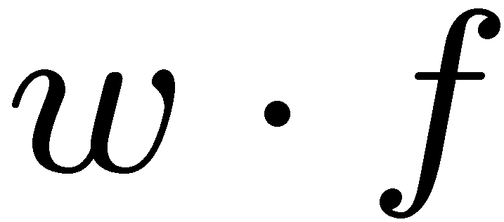
Weights
Binary case: compare features to a weight vector
Learning: figure out the weight vector from examples
# free : 4
YOUR_NAME :-1
MISSPELLED : 1
FROM_FRIEND :-3
...
# free : 2
YOUR_NAME : 0
MISSPELLED : 2
FROM_FRIEND : 0
...
# free : 0
YOUR_NAME : 1
MISSPELLED : 1
FROM_FRIEND : 1
...
Dot product positive means the positive class

Slide 28
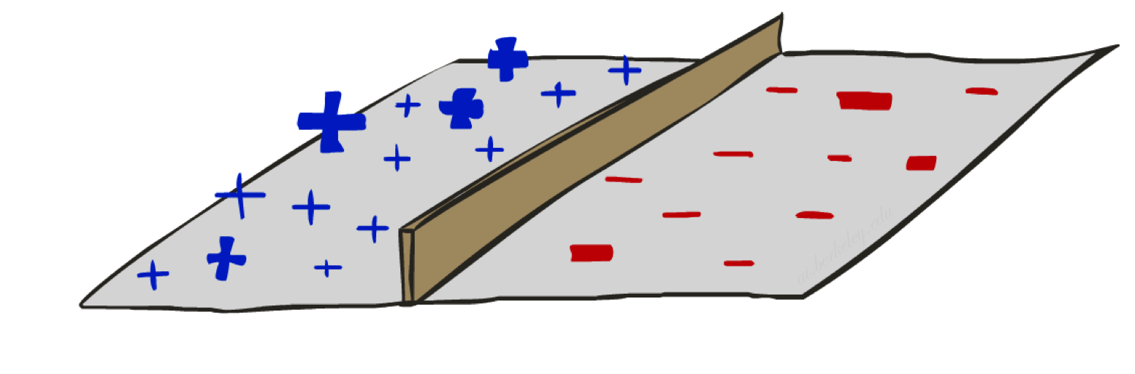
Threshold perceptron as linear classifier

Slide 29
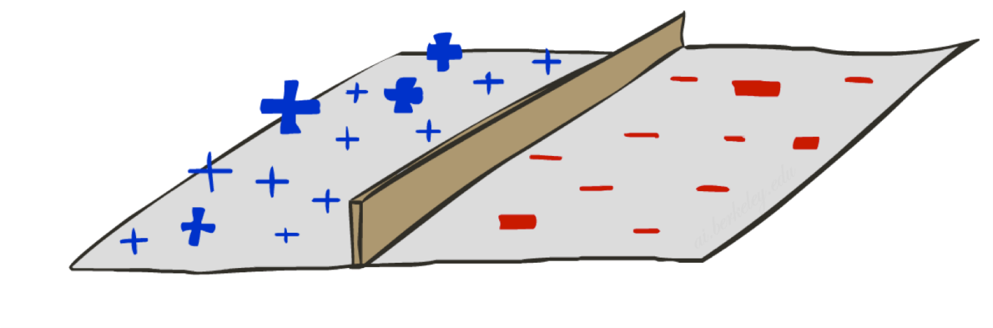
Binary Decision Rule
A threshold perceptron is a single unit that outputs
y = h_{w}(x) = 1 when w.x ≥ 0
= 0 when w.x < 0
In the input vector space
Examples are points x
The equation w.x=0 defines a hyperplane
One side corresponds to y=1
Other corresponds to y=0
money
w₀ : -3
w_{free} : 4
w_{money} : 2
2
y=1 (SPAM)
1
w.x=0
0
y=0 (HAM)
0
1
free

Slide 30
Example
Dear Stuart, I’m leaving Macrosoft
to return to academia. The money is
is great here but I prefer to be free
to do my own research; and I really
love teaching undergrads!
Do I need to finish
my BA first before applying?
Best wishes
Bill
money
w₀ : -3
w_{free} : 4
w_{money} : 2
2
y=1 (SPAM)
1
w.x=0
x₀ : 1
x_{free} : 1
x_{money} : 1
0
y=0 (HAM)
0
1
free
w.x = -3x1 + 4x1 + 2x1 = 3

Slide 31

Weight Updates

Slide 32
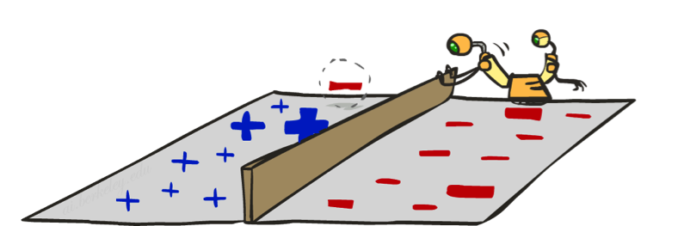
Perceptron learning rule
If true y ≠ h_{w}(x) (an error), adjust the weights
If w.x < 0 but the output should be y=1
This is called a false negative
Should increase weights on positive inputs
Should decrease weights on negative inputs
If w.x > 0 but the output should be y=0
This is called a false positive
Should decrease weights on positive inputs
Should increase weights on negative inputs
The perceptron learning rule does this:
w ← w + α (y – h_{w}(x)) x
learning rate
+1, -1, or 0 (no error)
Notes:
http://isl.ira.uka.de/neuralNetCourse/2004/VL_11_5/Perceptron.html

Slide 33
Example
Dear Stuart, I wanted to let you know
that I have decided to leave Macrosoft
and return to academia. The money is
is great here but I prefer to be free
to pursue more interesting research
and I really love teaching
undergraduates! Do I need to finish
my BA first before applying?
Best wishes
Bill
money
w₀ : -3
w_{free} : 4
w_{money} : 2
2
y=1 (SPAM)
1
w.x=0
x₀ : 1
x_{free} : 1
x_{money} : 1
0
y=0 (HAM)
0
1
free
w.x = -3x1 + 4x1 + 2x1 = 3
w ← w + α (y – h_{w}(x)) x
α = 0.5
w ← (-3,4,2) + 0.5 (0 – 1) (1,1,1)
= (-3.5,3.5,1.5)

Slide 34
Perceptron convergence theorem
Separable
A learning problem is linearly separable iff there is some hyperplane exactly separating +ve from –ve examples
Convergence: if the training data are separable, perceptron learning applied repeatedly to the training set will eventually converge to a perfect separator
Non-Separable

Slide 35
Perceptron convergence theorem
Separable
A learning problem is linearly separable iff there is some hyperplane exactly separating +ve from –ve examples
Convergence: if the training data are separable, perceptron learning applied repeatedly to the training set will eventually converge to a perfect separator
Convergence: if the training data are non-separable, perceptron learning will converge to a minimum-error solution provided the learning rate α is decayed appropriately (e.g., α=1/t)
Non-Separable

Slide 36
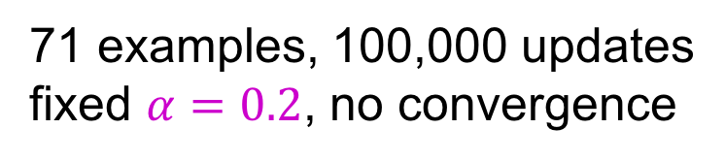
Perceptron learning with fixed α
71 examples, 100,000 updates
fixed $α=0.2$, no convergence

Slide 37
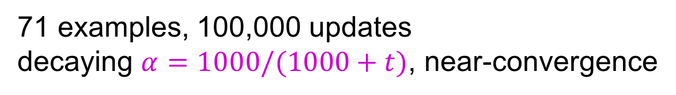
Perceptron learning with decaying α
71 examples, 100,000 updates
decaying $α=1000/(1000+t)$, near-convergence

Slide 38
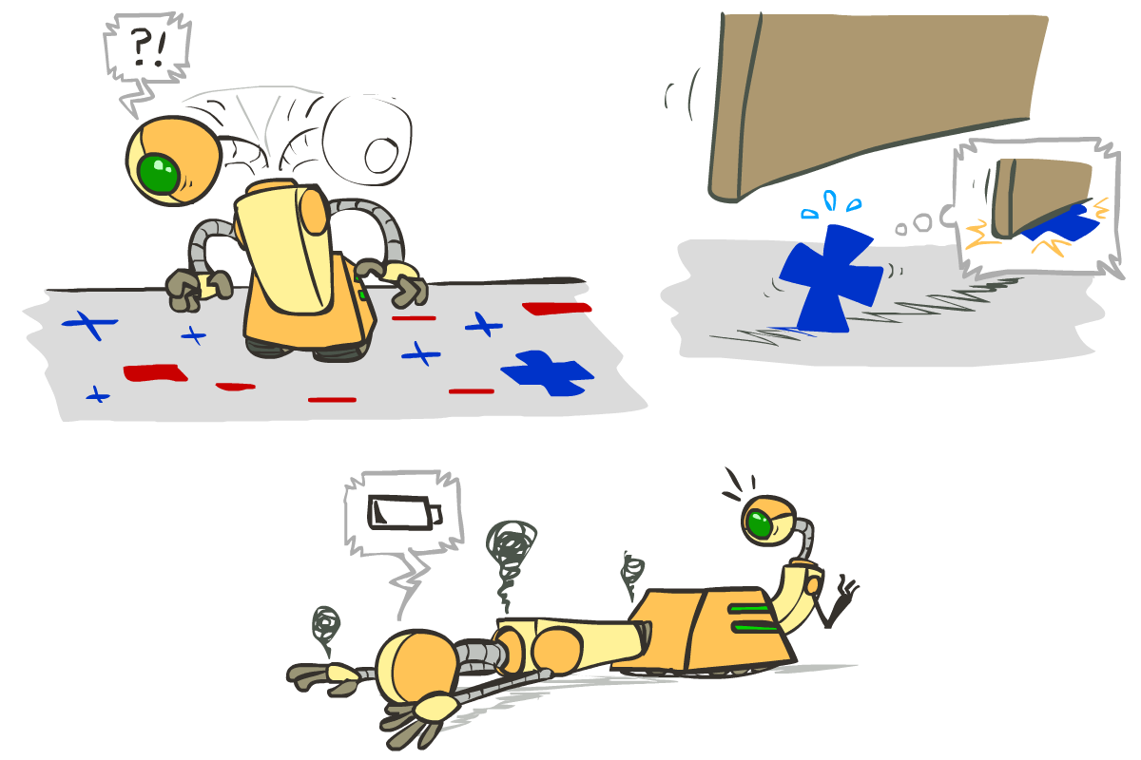




Problems with the Perceptron
Noise: if the data isn’t separable, weights might thrash
Averaging weight vectors over time can help (averaged perceptron)
Mediocre generalization: finds a “barely” separating solution
Overtraining: test / held-out accuracy usually rises, then falls
Overtraining is a kind of overfitting

Slide 39

Improving the Perceptron

Slide 40
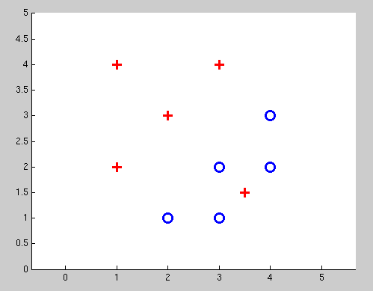
Non-Separable Case: Deterministic Decision
Even the best linear boundary makes at least one mistake

Slide 41
Non-Separable Case: Probabilistic Decision
0.9 | 0.1
0.7 | 0.3
0.5 | 0.5
0.3 | 0.7
0.1 | 0.9

Slide 42
How to get probabilistic decisions?
Perceptron scoring:
If very positive → want probability going to 1
If very negative → want probability going to 0
Sigmoid function

Slide 43
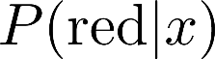
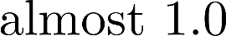
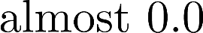
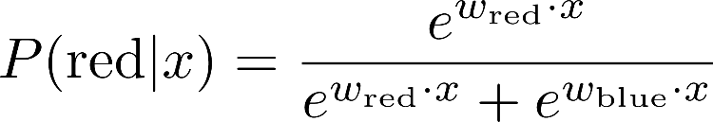
A 1D Example
definitely blue
not sure
definitely red
probability increases exponentially as we move away from boundary
normalizer

Slide 44
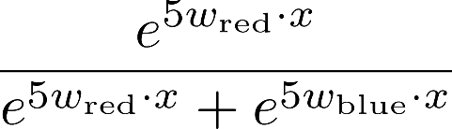
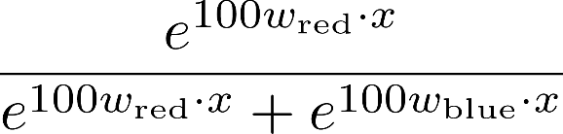
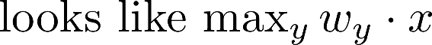
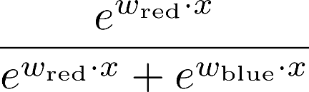
The Soft Max

Slide 45
Best w?
Maximum likelihood estimation:
with:
= Logistic Regression

Slide 46
Separable Case: Deterministic Decision – Many Options

Slide 47
Separable Case: Probabilistic Decision – Clear Preference
0.7 | 0.3
0.5 | 0.5
0.7 | 0.3
0.3 | 0.7
0.5 | 0.5
0.3 | 0.7

Slide 48
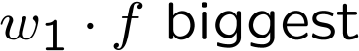


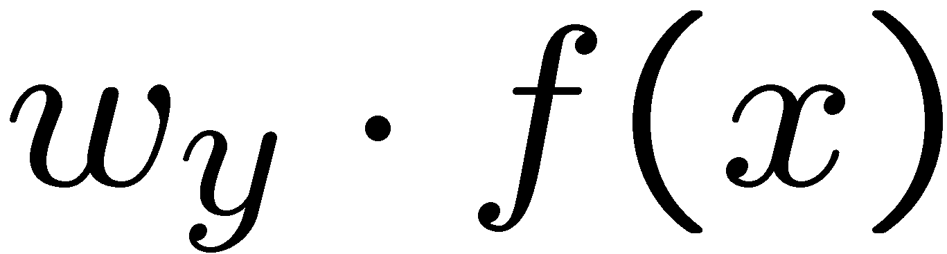


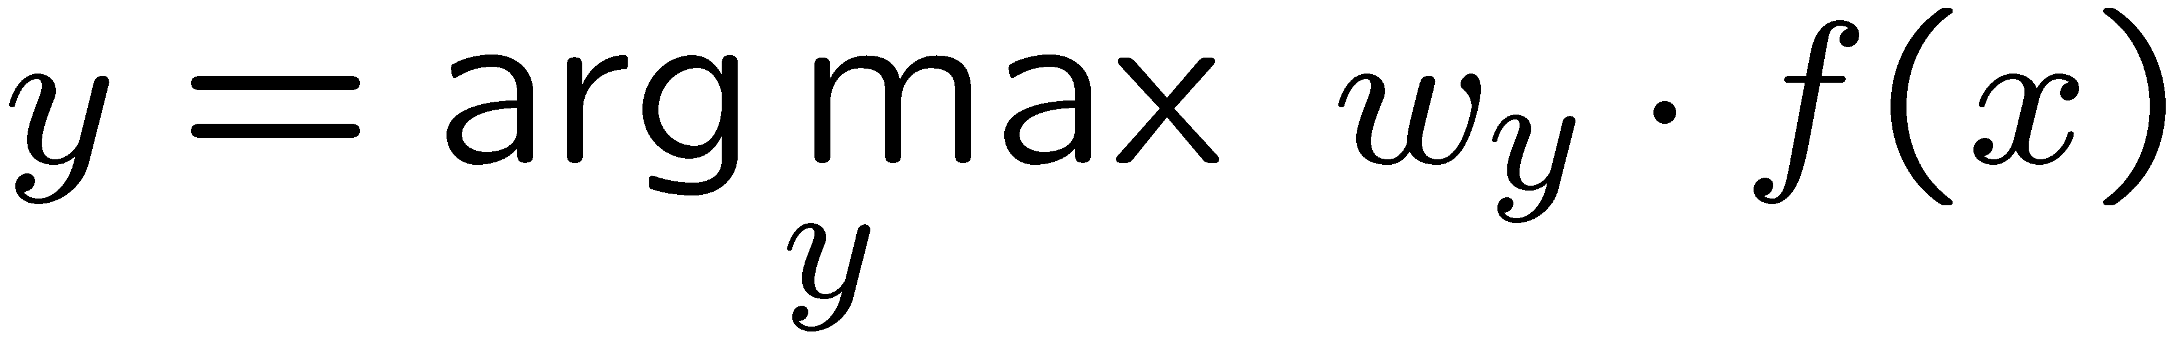
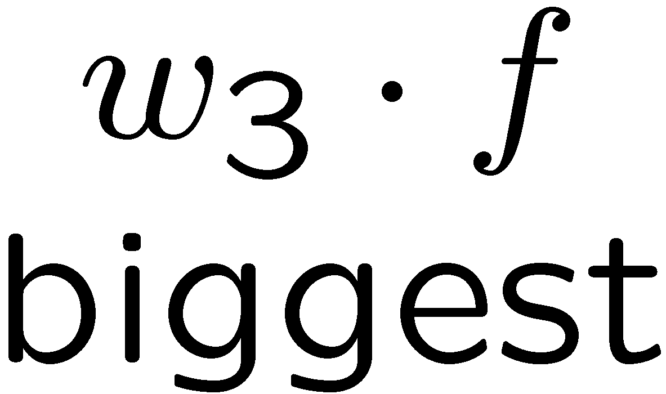
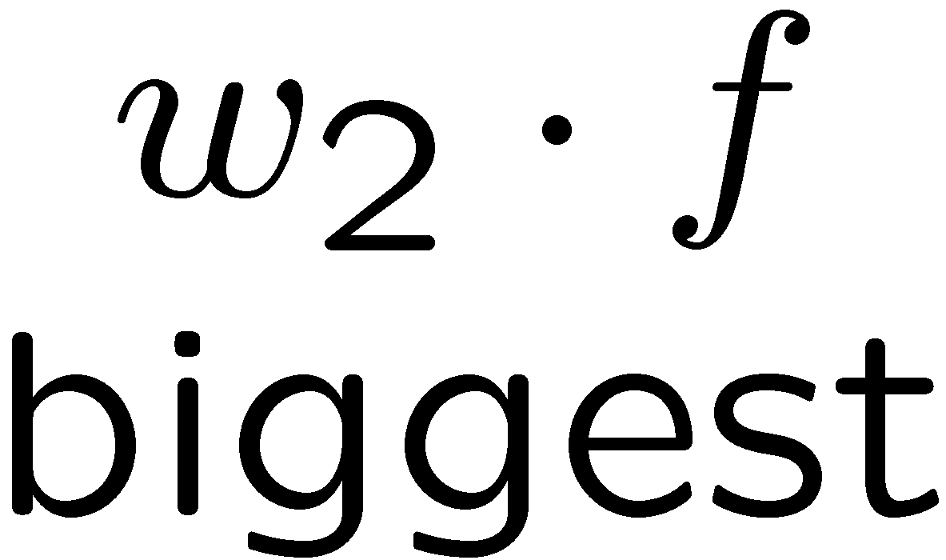
Multiclass Logistic Regression
Recall Perceptron:
A weight vector for each class:
Score (activation) of a class y:
Prediction highest score wins
How to make the scores into probabilities?
original activations
softmax activations

Slide 49
Best w?
Maximum likelihood estimation:
with:
= Multi-Class Logistic Regression

